Slide 1

Comprehensive Guide to Data Extraction
Tools and Techniques for Successful Data Extraction
Notes:
In this presentation, we will explore the key concepts and challenges in data extraction, as well as the tools and techniques for extracting data from various sources.

Slide 2

Presentation Overview
Basics of Data Extraction
  We will discuss the fundamental concepts of data extraction, including its role in the data lifecycle, the challenges it poses, and the various techniques used to overcome them.
Data Sources and Integration Challenges
  We will explore the different types of data sources and common data source systems, as well as the data flow and integration challenges that arise when working with them.
Impact of IoT on Data Extraction
  We will dive into the topic of IoT and its impact on data extraction, including its key components, data sources, and extraction challenges.
Tools and Techniques for Data Extraction from IoT Devices
  We will examine the various tools and techniques used to extract data from IoT devices, including data extraction software, APIs, and data integration platforms.
Notes:
We will start by discussing the basics of data extraction, including its role in the data lifecycle and the challenges involved. Then, we will explore the different types of data sources and common data source systems, as well as the data flow and integration challenges. We will also dive into the topic of IoT and its impact on data extraction, including its key components, data sources, and extraction challenges. Finally, we will examine the tools and techniques for extracting data from IoT devices.

Slide 3
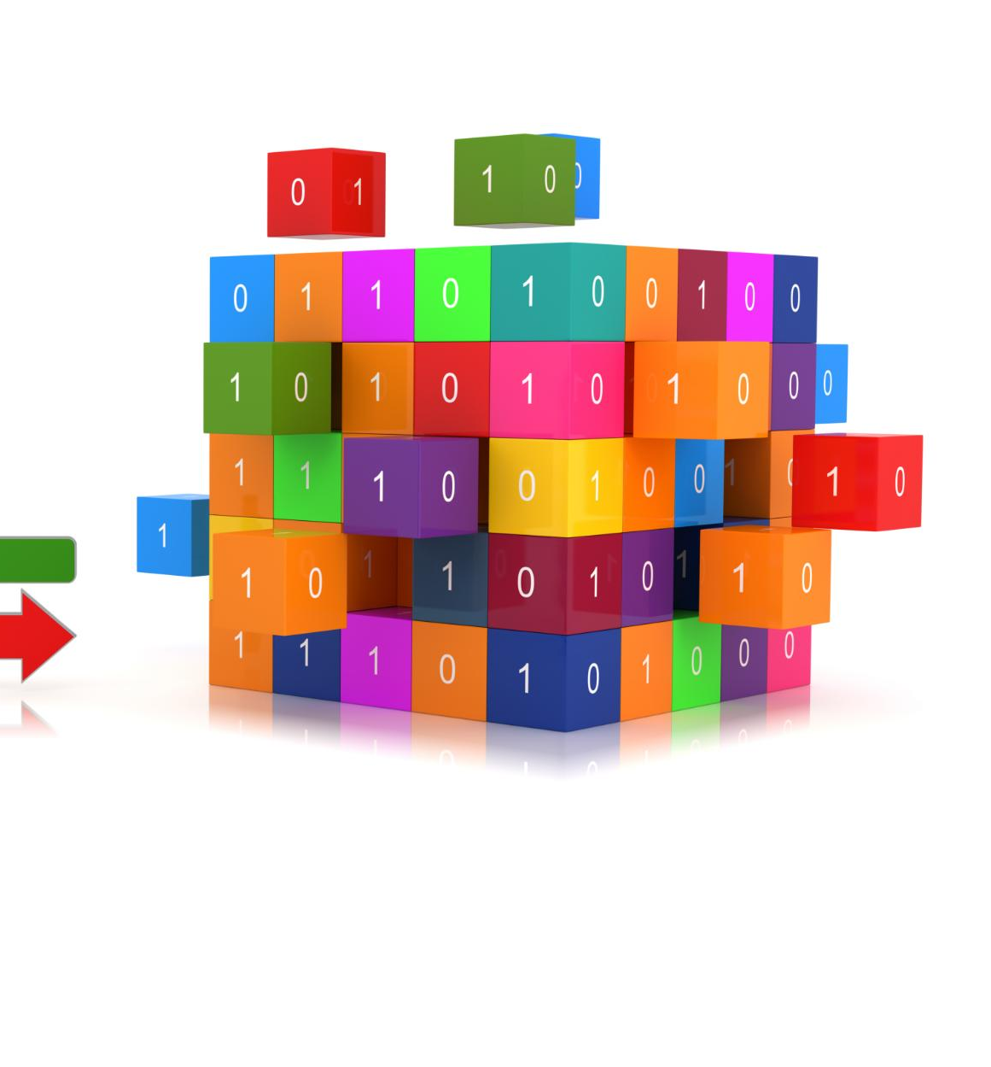
Introduction to Data Extraction
Data Extraction Process
  Data extraction involves retrieving data from various sources and transforming it into a format suitable for analysis. It is a critical step in the data lifecycle, enabling organizations to gather insights and make informed decisions.
Challenges in Data Extraction
  Data extraction can be challenging due to the variety of sources and formats, as well as data quality issues. Ensuring data accuracy and completeness is crucial in the data extraction process.
Notes:
Data extraction is the process of retrieving data from various sources and transforming it into a format suitable for analysis. It plays a critical role in the data lifecycle, as it enables organizations to gather insights and make informed decisions. However, data extraction can be challenging due to the variety of sources, formats, and data quality issues.

Slide 4

Overview of Data Extraction
Data Collection
  Data extraction involves collecting data from various sources, such as databases, files, and APIs, and transforming it into a format that can be used for data analysis and visualization.
Data Transformation
  Data extraction involves transforming raw data into a structured format that can be used for analysis and visualization. This involves cleaning, sorting, and filtering data to create meaningful insights.
Notes:
Data extraction involves collecting and transforming data from various sources, such as databases, files, and APIs. It is a crucial step in the data lifecycle, as it enables organizations to analyze and gain insights from their data.

Slide 5
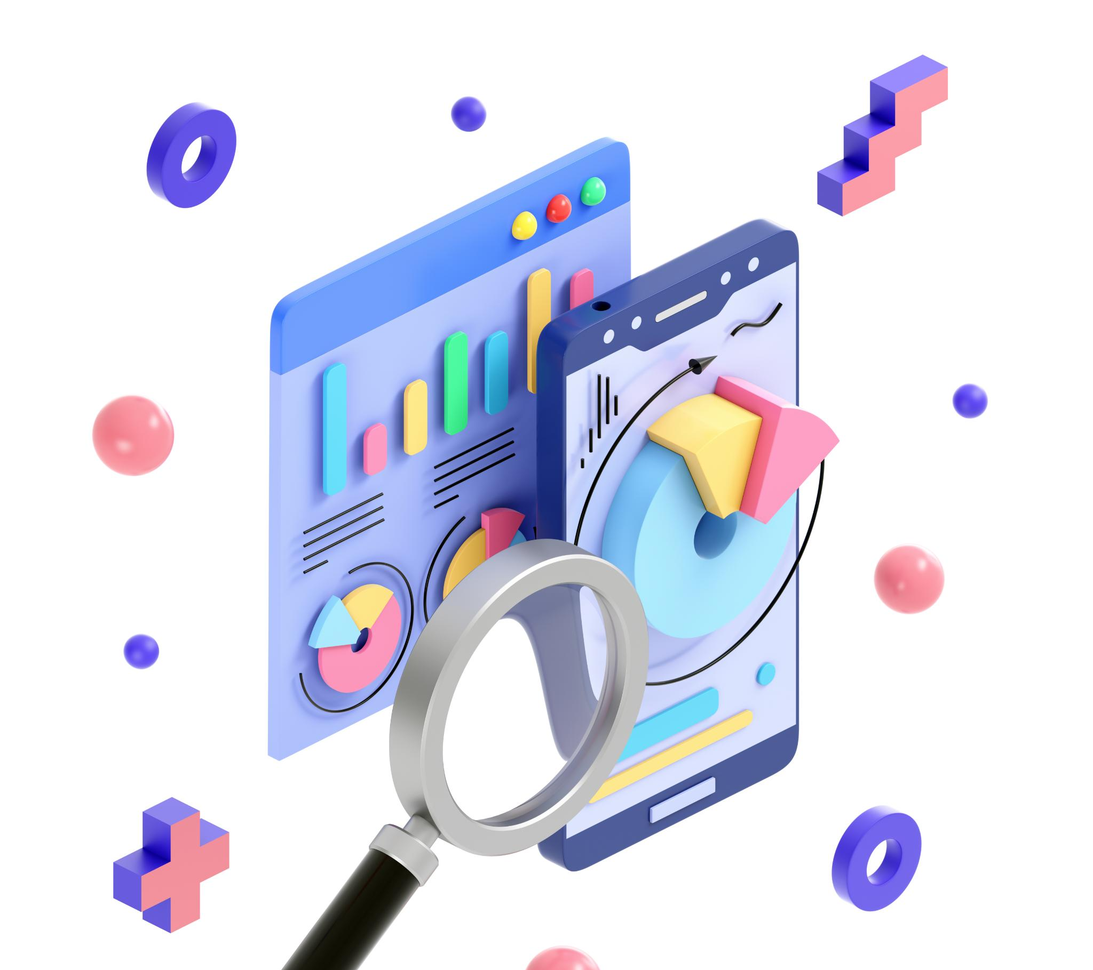
The Role of Data Extraction in the Data Lifecycle
  Data extraction is a critical step in the data lifecycle, as it enables organizations to collect and transform raw data into meaningful insights that aid in decision-making processes.
Notes:
Data extraction plays a critical role in the data lifecycle, as it allows organizations to gather insights and make informed decisions based on their data. It is the first step in the process of transforming raw data into meaningful insights.

Slide 6
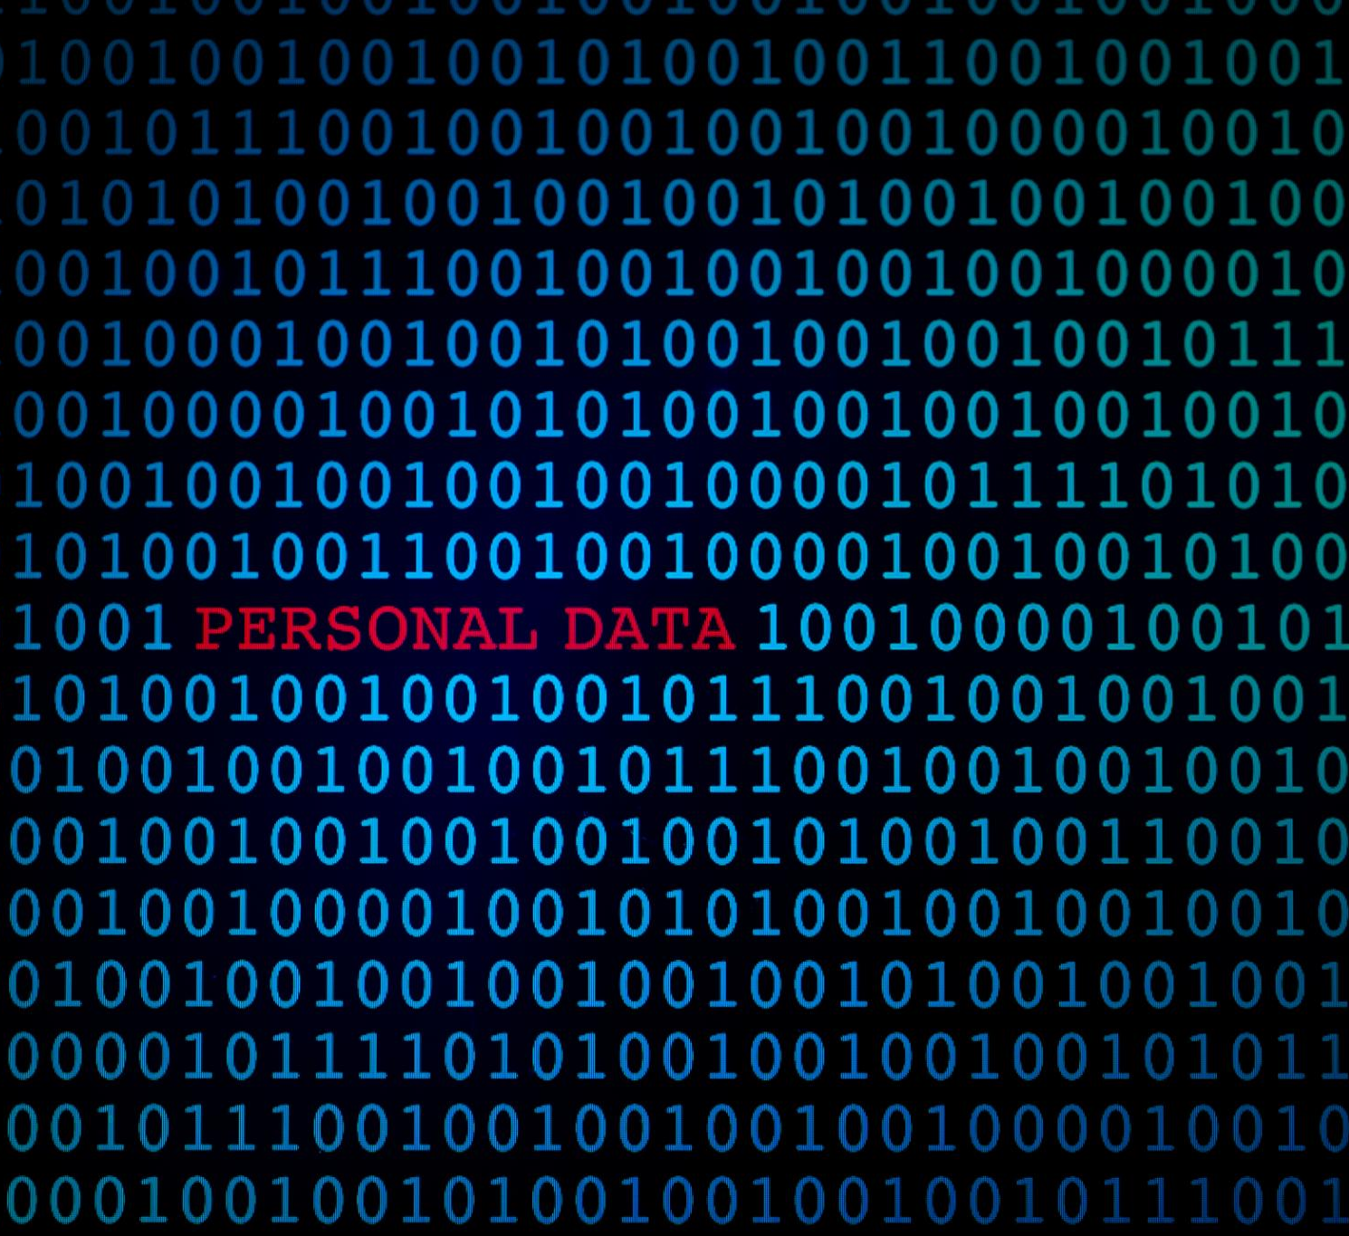
Key Challenges in Data Extraction
Variety of Data Sources
  Data extraction can be challenging due to the variety of sources. Organizations need to ensure that the data they extract is accurate, complete, and consistent, which can be a difficult task when dealing with data from multiple sources.
Data Quality Issues
  Data quality issues can pose a major challenge to data extraction. Organizations need to ensure that the data they extract is accurate, complete, and consistent, which can be difficult when dealing with data that is inconsistent, missing, or contains errors.
Large and Complex Data Sets
  Data extraction can be a difficult task when dealing with large and complex data sets. Organizations need to ensure that the data they extract is accurate, complete, and consistent, which can be challenging given data sets that contain a large amount of data or are structured in a complex way.
Notes:
Data extraction can be challenging due to the variety of sources, formats, and data quality issues. Organizations need to ensure that the data they extract is accurate, complete, and consistent, which can be a difficult task when dealing with large and complex data sets.

Slide 7
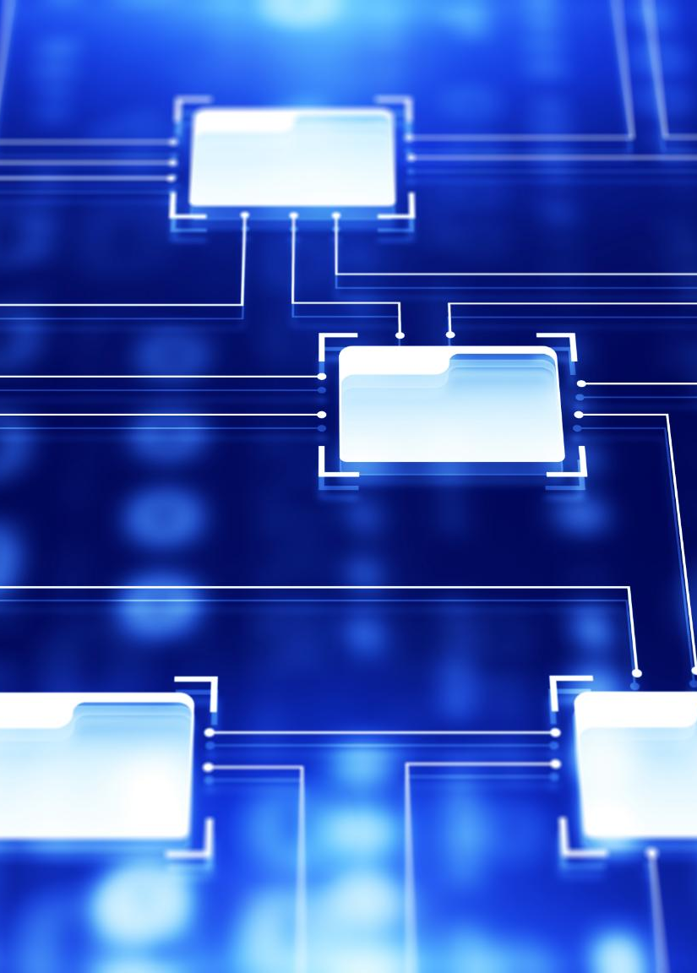
Understanding Data Sources in Greater Detail
Data Sources
  To extract data effectively, it is important to understand the different types of data sources, such as databases, APIs, cloud storage, and file systems.
Data Source Systems
  Common data source systems include relational database management systems (RDBMS), NoSQL databases, and search engines.
Data Flow Across Platforms
  Data flows across platforms through various methods such as batch processing, real-time streaming, and message queuing systems.
Notes:
To extract data effectively, it is important to understand the different types of data sources, common data source systems, and the flow of data across platforms.

Slide 8
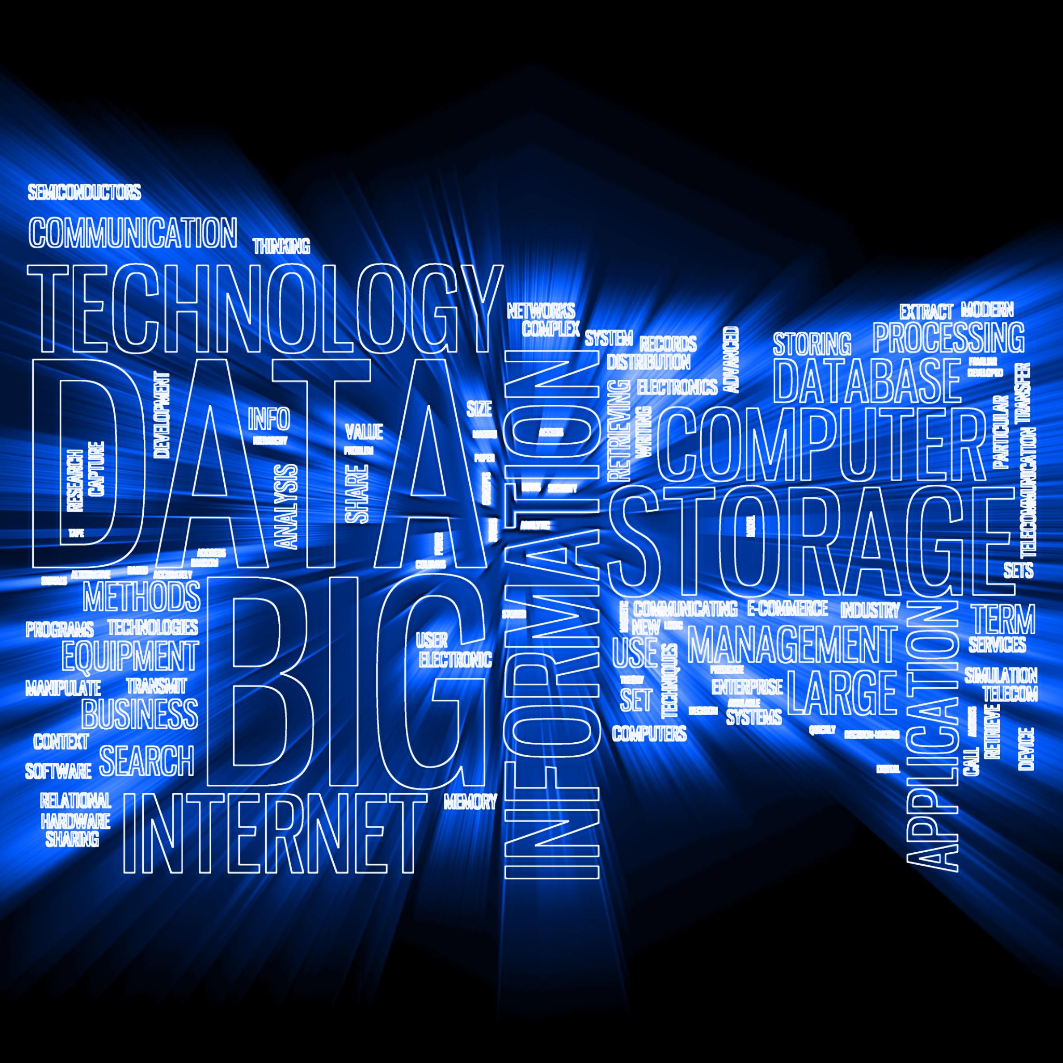
Types of Data Sources
Internal and External Sources
  Data sources can be internal or external. Internal sources include data from within an organization, while external sources include data from outside an organization such as public data, social media, and customer data.
Structured and Semi-Structured Data
  Data sources can be structured or semi-structured. Structured data is highly organized and formatted, while semi-structured data is partially organized and formatted.
Unstructured Data
  Data sources can also be unstructured, which means the data is not organized or formatted in a specific way. Examples of unstructured data include email, text documents, and social media posts.
Real-Time and Batch Processing
  Data sources can be processed in real-time or in batches. Real-time processing means data is processed as soon as it is received, while batch processing means data is processed in batches at specific intervals.
Notes:
Data sources can be internal or external. They can also be structured, semi-structured, or unstructured, and can be real-time or batch.

Slide 9
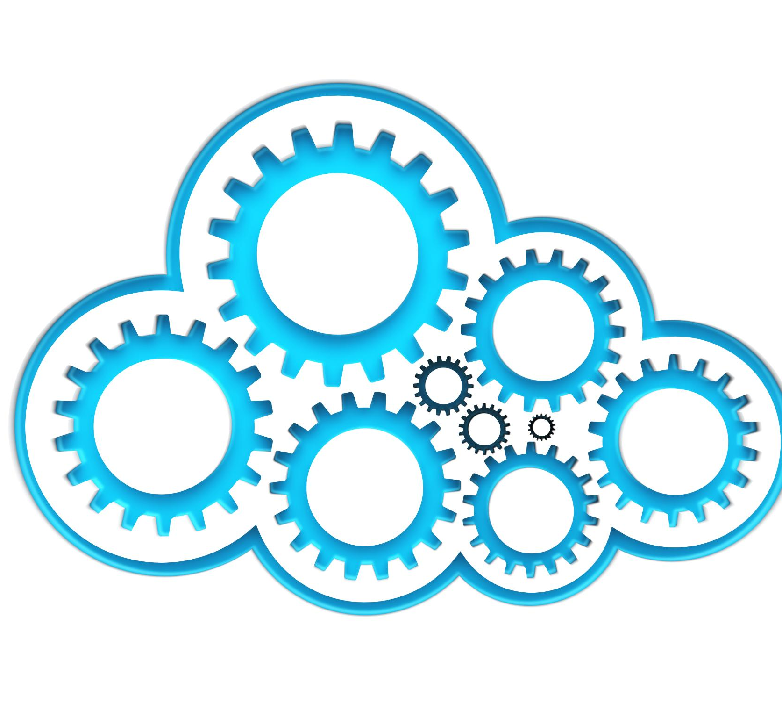
Common Data Source Systems
Transactional Systems
  Transactional systems like ERP and CRM are common data source systems that organizations use to manage their core business processes and data.
Legacy Systems
  Legacy systems are older, often outdated computer systems that are still in use by organizations. They can be challenging to integrate with modern data source systems.
Modern Applications and APIs
  Modern applications and APIs are becoming increasingly important as data source systems, as more business processes move to the cloud and require integration with other systems.
Sensors, IoT Devices, and Social Media Platforms
  Sensors, IoT devices, and social media platforms are newer sources of data that are growing in importance for organizations as they look to collect data from a wide range of sources.
Notes:
Common data source systems include transactional systems like ERP and CRM, legacy systems, modern applications, APIs, sensors, IoT devices, social media platforms, and third-party data services.

Slide 10
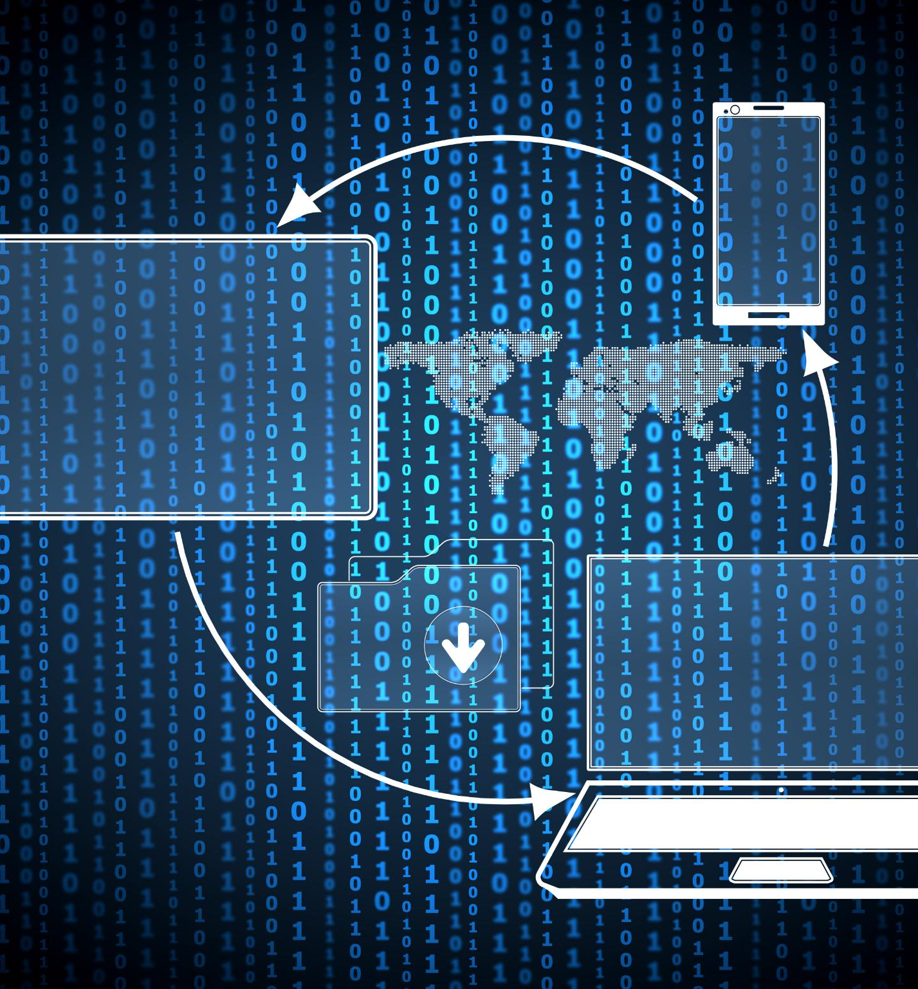
Data Flow and Integration
Data Silos
  Data silos are a common problem in organizations where data is stored in different systems and platforms, making it difficult to extract and analyze. Integration of data across platforms can help overcome this problem.
Data Integration
  Data integration is the process of combining data from different sources and platforms into a single, unified view. This helps organizations to extract and analyze data more effectively.
Notes:
Data silos can hinder the extraction of data, and organizations need to integrate data across platforms to extract and analyze it effectively.

Slide 11

Internet of Things (IoT) and Data Extraction
  IoT devices are transforming data extraction by providing real-time data from a variety of sources, enabling organizations to make better decisions, optimize resources, and improve operational efficiencies.
Notes:
IoT is a rapidly growing field that is transforming data extraction by providing real-time data from a variety of sources.

Slide 12
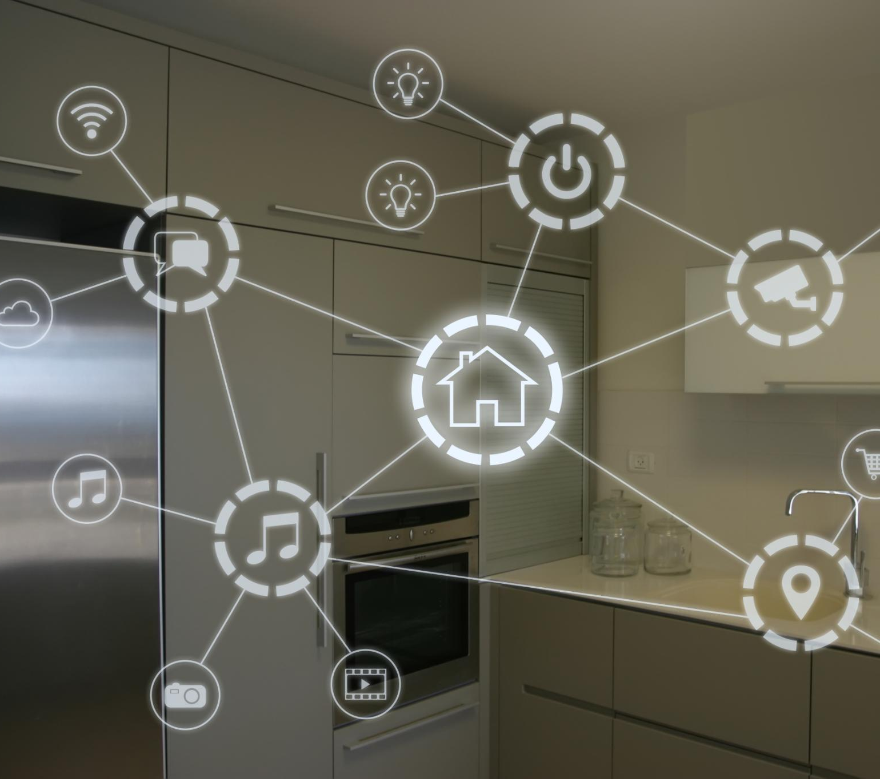
Understanding IoT
  The Internet of Things (IoT) is a network of interconnected devices that use sensors, software and network connectivity to improve efficiency and automate processes in various industries and applications.
Notes:
IoT refers to the network of physical devices, vehicles, buildings, and other objects that are embedded with sensors, software, and network connectivity. Key components of IoT include sensors, actuators, and connectivity.

Slide 13

IoT Data Sources
Real-time Data Streams
  IoT devices generate real-time data streams that are used as a data source for IoT applications. These data streams are used to monitor and control the devices in real-time and provide valuable insights into device performance and usage patterns.
Data Extraction from IoT Sensors
  IoT sensors generate data that is extracted using protocols like MQTT and CoAP. This data is used to monitor and control various aspects of the environment and provide valuable insights into usage patterns and environmental conditions.
Notes:
IoT data sources include real-time data streams from IoT devices and data extraction from IoT sensors using protocols like MQTT and CoAP.

Slide 14
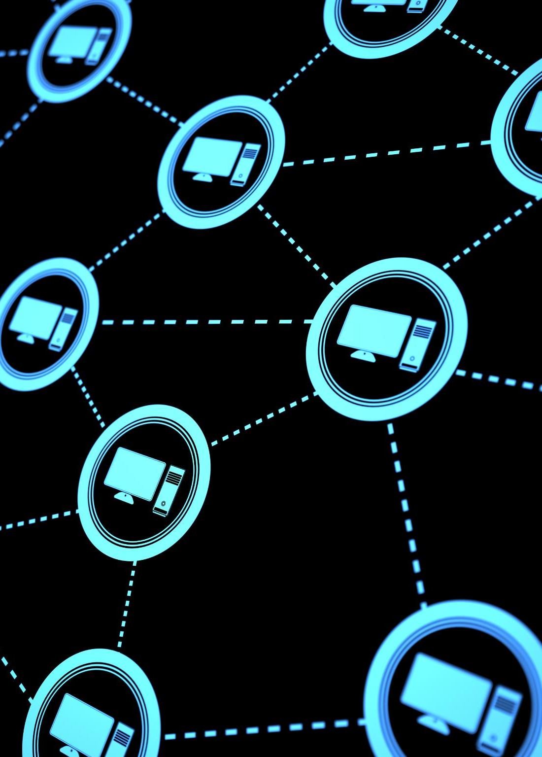
Challenges in Extracting IoT Data
Continuous Data Streams
  IoT devices generate continuous data streams, which can make it difficult to extract and analyze the data effectively and efficiently.
Volume of Data
  The volume of data generated by IoT devices can be enormous, making it challenging to store and process the data efficiently.
Data Quality and Reliability
  Data quality and reliability can be a challenge when extracting data from IoT devices, as the data may be incomplete, inaccurate, or inconsistent.
Notes:
Extracting data from IoT devices can be challenging due to the continuous data streams and volume, as well as data quality and reliability issues.

Slide 15

Tools for Extracting IoT Data
AWS IoT
  AWS IoT is a platform that enables users to easily and securely connect and manage IoT devices and extract data from them. It provides features like device management, security, and integration with other AWS services.
Google IoT Core
  Google IoT Core is a fully-managed service that allows users to securely connect, manage, and ingest data from IoT devices. It provides features like device management, security, and integration with other Google Cloud services.
Apache Kafka
  Apache Kafka is an open-source streaming platform that is widely used for building real-time data pipelines and streaming applications. It provides features like scalability, fault-tolerance, and integration with other big data tools.
Apache Spark
  Apache Spark is an open-source distributed computing system that is used for processing large-scale data sets. It provides features like in-memory processing, fault-tolerance, and integration with other big data tools.
Notes:
Tools for extracting IoT data include platforms like AWS IoT and Google IoT Core, as well as integration with big data tools like Apache Kafka and Spark.

Slide 16

Conclusion
Importance of Data Extraction
  Data extraction is a critical step in the data lifecycle, allowing organizations to extract valuable insights and make informed decisions. Organizations must understand the key concepts and techniques for extracting data effectively.
IoT Data Extraction
  With the growing importance of IoT, organizations need to be able to extract and analyze data from a variety of sources, including sensors, devices, and machines, and use the right tools and techniques to gain insights and make informed decisions.
Notes:
Data extraction is a critical step in the data lifecycle, and it is important for organizations to understand the key concepts and techniques for extracting data effectively. With the growing importance of IoT, organizations need to be able to extract and analyze data from a variety of sources, and use the right tools and techniques to gain insights and make informed decisions.

